Slide 1

Kick-Off Meeting
Sol. W9124D-23-R-0007
Information Technology Support Services (ITSS), U.S. Army Recruiting Command
Proprietary and Confidential - HunaTek

Slide 2
Short Turn-Around
Proposals are due October 27, 2022 09:00 a.m. ET

Slide 3
Agenda
Team Composition
Schedule
Opportunity Overview
Proposal Development
Action Items
Discussion & Questions

Slide 4
Team Composition
Team | Contact Person | email
HunaTek | Tim Fitzgerald Tom Termini - proposal coordinator Keith Nicoletti | tim.Fitzgerald@Hunatek.com tomtermini@gmail.com keith.nicoletti@Hunatek.com
Culmen | Mark Dumas Geoff Hill | Mark.Dumas@culmen.com Geoff.Hill@culmen.com

Slide 5
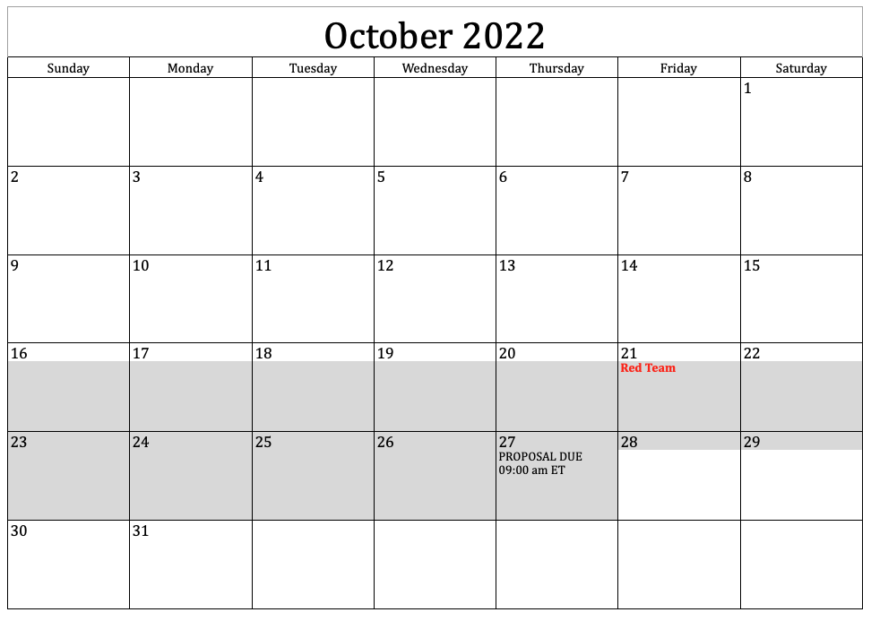
Schedule

Slide 6
Opportunity Overview
Information Technology Support Services (ITSS), U.S. Army Recruiting Command, Fort Knox, KY (USAREC)
Enterprise-Wide Strategic Sourcing vehicle providing professional support services, provide a department-wide vehicle for a broad range of general management and business support services and solutions
USAREC is at the center of the Army's initiative to mold military personnel functions into an improved structure, enabling efficient and effective management of accessioning Army active duty and ReserveSoldiers worldwide. USAREC’s focus is on the integration and coordination of military personnel accessioning systems and to develop/optimize and provide the strength of Army accessioning in peacetime and war. The Command performs all accessioning functions for the distribution, development, and transition to Active duty, including Reserve Soldiers. The primary location of the accessioning mission is Fort Knox, KY; with a small number of resources in several locations in the Continental U.S. (CONUS) and Outside the Continental U.S. (OCONUS) locations. The footprint of the accessioning mission is worldwide.

Slide 7

Proposal Development Plan
GSA STARS III TOR 8(a) competitive bid
FFP with ODC CLINs
Questions due tomorrow 9:00 am ET, 19 October 2022
Proposal has two (2) separate documents
Document 1.
1.1 Technical Capability (Twenty (20) pages)
1.2 Staffing Plan (Five (5) pages)
1.3 Experience (Two (2) pages)
Document 2. Price Submission (No page limitation)
Questions Due: 9:00 am ET, Wednesday, 19 October 2022
RESPONSE DUE DATE, SUBMISSION MODE AND LOCATION
Proposal due date: October 27, 2022
Time: 09:00 a.m. ET
Location: Email to
Procuring Contracting Officer; JoDeen M. Cuffe, jodeen.m.cuffe.civ@army.mil
Contract Specialist; Deborah R. Davis-Maxwell, Deborah.r.davis-maxwell.civ@army.mil

Slide 8
Evaluation
The Government will award a contract resulting from this solicitation to the responsible offeror whose offer conforming to the solicitation will be most advantageous to the Government, price and other factors considered. The following factors shall be used to evaluate offers:
(i) Non-Price Factor:
Technical capability
Staffing Plan
Experience
(ii) Price Factor: Evaluation will consider non-price factors and price. In the evaluation, Technical capability and Resource Information are of equal importance, and individually more important than Experience. Non-price factors, when combined, are more important than price. However, price will become more important when non-price factors among the responses is more equal. The Government will perform a price/technical trade-off analysis to select the best-suited contractor that provides the best value.

Slide 9
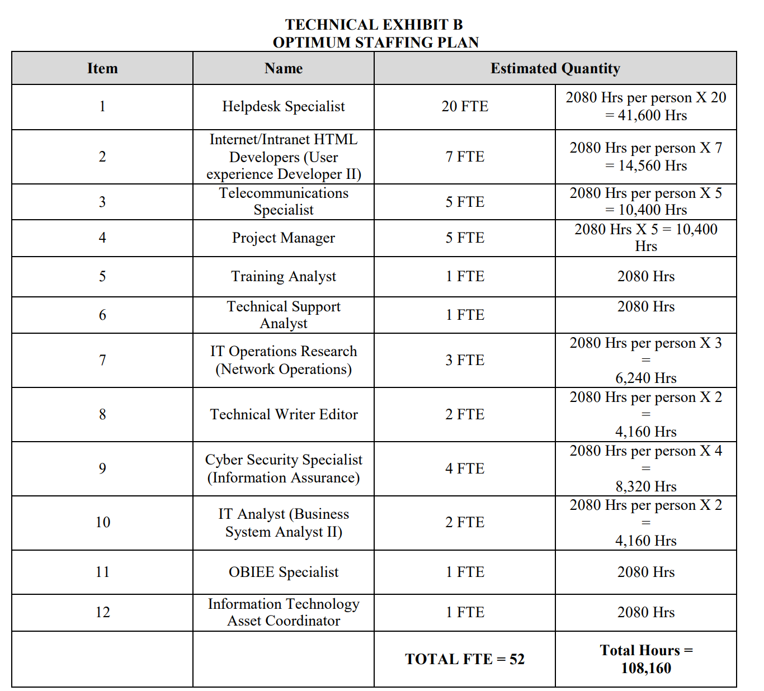
BOE Mystery
$15.6M dollar figure equates to about twenty (20) FTE’s however, 2019 USAREC ITSS RFP listed Fifty-Two (52).
2019 RFP

Slide 10
Proposal Development
Kick-off - Today!
Contacts
Schedule
Outline, Writing Assignments
Data Call(s)
Review Team (Red)

Slide 11
Some Notes on the Proposal
Need to review Writing Template, quickly assign authors/writers, conduct review this Friday, 21 October 2022
Identify POC to collect questions and submit NLT 9:00 am tomorrow (Wednesday, 19 October 2022)
Identify PM with Resume

Slide 12
Action Items
Update Contacts for Technical and Pricing
Data Call #1
“Pink” version outline

Slide 13
Discussion & Questions
Timothy J. Fitzgerald Chief Operating Officer tim.Fitzgerald@Hunatek.com tel 571-464-5198
Keith R. Nicoletti Director of Business Development keith.Nicoletti@hunatek.com tel (571) 241-7516
Tom Termini Proposal Coordinator termini@bluedog.net | tomtermini@gmail.com tel 301-649-5000

